Slide 1
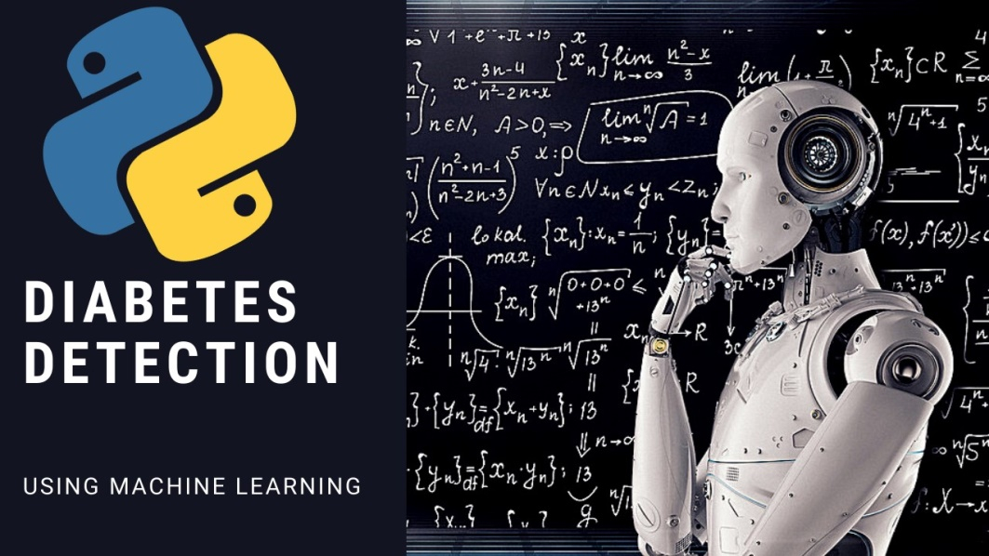
DIABETES PREDICTION USING DATA-SCIENCE EXPOSYS DATALABS INTERNSHIP PROJECT
By
SOUHARDYA GAYEN

Slide 2

Agenda
What is Diabetes?
Advantage of Predicting Diabetes
Introduction to Machine learning
Different Machine Learning algorithm
Steps Of Predicting Diabetes
Proposed Methodology
Architecture
Architecture Diagram
Implementation
Result Discussion

Slide 3
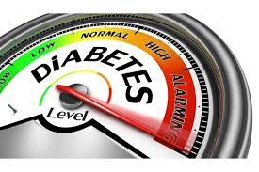
What is Diabetes?
Diabetes is an illness caused because of high glucose level in a human body.
Diabetes should not be ignored if it is untreated then Diabetes may cause some major issues in a person like: heart related problems, kidney problem, blood pressure, eye damage and it can also affects other organs of human body.

Slide 4
Advantage of Predicting Diabetes
Diabetes can be controlled if it is predicted earlier.
It will be helpful for the person to know that whether he or she have diabetes or not , so that he/she can follow the proper diet to control it.
When detected early, the patient may not only delay but even prevent progression to diabetes.
Disease prevention is significantly less expensive than the treatment and diabetic complications.

Slide 5
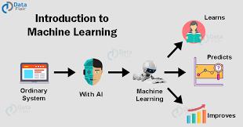
Introduction to Machine learning
Machine learning is a subfield of artificial intelligence (AI).
Because of this, machine learning facilitates computers in building models from sample data in order to automate decision-making processes based on data inputs.
Machine learning algorithms use historical data as input to predict new output values.

Slide 6
Different Machine Learning algorithm
Here is the list of commonly used machine learning algorithms. These algorithms can be applied to almost any data problem:
Linear Regression
Logistic Regression
Decision Tree
SVM
Naive Bayes
KNN (K-Nearest Neighbours)
K-Means
Random Forest
Dimensionality Reduction Algorithms.

Slide 7
Different Machine Learning algorithm
There are also Gradient Boosting Algorithms:
1. GBM
2. XGBoost
3. Light GBM
4. CatBoost

Slide 8
Steps Of Predicting Diabetes
Step1: Import required libraries, Import diabetes dataset.
Step2: Pre-process data to remove missing data.
Step3: Perform percentage split of 80% to divide dataset as Training set and 20% to Test set.
Step4: Select the machine learning algorithm i.e. K- Nearest Neighbour, Support Vector Machine, and Naive Bias.

Slide 9
Steps Of Predicting Diabetes
Step5: Build the classifier model for the mentioned machine learning algorithm based on training set.
Step6: Test the Classifier model for the mentioned machine learning algorithm based on test set.
Step7: Perform Comparison Evaluation of the experi mental performance results obtained for each classifier.
Step8: After analyzing based on various measures conclude the best performing algorithm.

Slide 10
Proposed Methodology
In the conducted research the purpose is to classify the data available into diabetic or non-diabetic using the supervised learning algorithms. The dataset will be divided into training and testing sets. In order to achieve more accuracy we must train more data. Then we will do a comparative analysis on the results achieved from the algorithms for early detection of diabetes. The models like Support vector machine, Naive Bayes prove to be most useful in detection of diabetes in a patient. The centre objective of our model is to achieve a better accuracy and overall improvement in early diagnosis of diabetes.

Slide 11
Architecture
The system will detect whether the person has diabetes or not using the dataset. If diabetes is detected the classification value will be 1 and if not the value will be 0.
We will be using 3 machine learning model in order to detect the disease. The models used are KNN, Support vector machine and Naive Bayes. The system architecture will help in the future too diagnosis diabetes. It will also predict whether someone has diabetes or not on the basis of using a trained dataset.

Slide 12
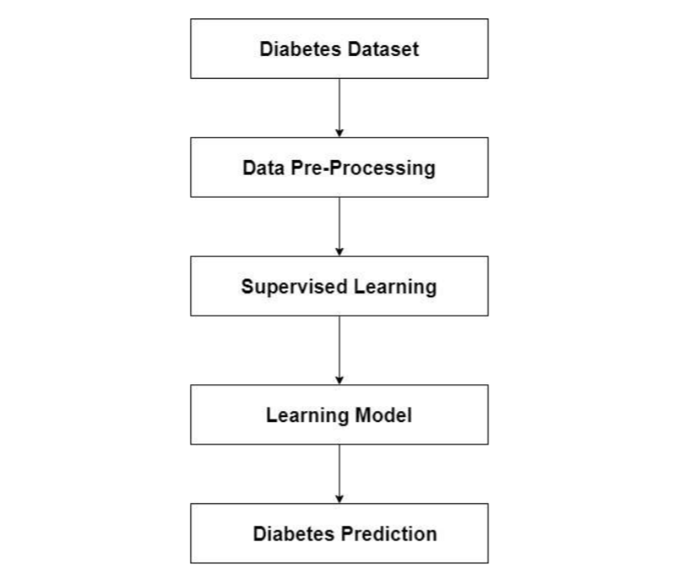
Architecture Diagram

Slide 13
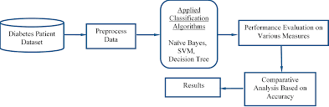
IMPLEMENTATION
In computer science, an implementation is a realization of a technical specification or algorithm as a program, software component, or other computer system through computer programming and deployment. Many implementations may exist for a given specification or standard. For example, web browsers contain implementations of World Wide Web Consortium-recommended specifications, and software development tools contain implementations of programming languages

Slide 14
Result Discussion
In this Project Study, The higher accuracy the better prediction rate we will achieve. The SVM and KNN algorithm obtained the best accuracy. While on the other hand Naive Bias had the lowest score.
The overall experimentation displayed that KNN and SVM is better than other algorithms (Naive Bias) in diabetes prediction.
Algorithm | Accuracy
KNN | 81.68%
SVM | 81.68%
Naïve Bias | 77.92%.

Slide 15
Result Discussion
So we have not taken the Naïve bias Classifier as its giving the less accuracy. So we have used either SVM classifier or KNN classifier to predict Diabetes
The result will be like ,If diabetes is detected the classification value will be 1 and if not the value will be 0.
So when the prediction value is '1', it will show "The person is Diabetic" and if its '0' then it will show "The person is not diabetic".

Slide 16
THANK YOU

